Slide 1
TOPIC:CUSHING SYNDROME
GROUP 7 MEMBERS
NAMES
GC NUMBERS
FATOUMATTA CEESAY
FATOUMATA S TOURAY
GAFUREH JABBIE
LOLLY NYANG
BINTA KANYI
FATOUMATA JARRA FATTY
ESTHER UMEJESI
ALAGIE JALLOW
FATOUMATA A SOWE
2431127
2431035
2431144
2431145
2431164
2431073
2331133
2431162
2431153

Slide 2
PRESENTATION OUTLINE
INTRODUCTION
DEFINITION
AETIOLOGY
PATHOSPHYSIOLOGY
TYPES
SIGN AND SYMPTOM
INVESTIGATION
MEDICAL/NURSING MANAGEMENT
NURSING DIAGNOSIS
COMPLICATIONS
DIFFERENTIAL DIAGNOSIS
REFERENCE

Slide 3
INTRODUCTION
Cushing syndrome is a disorder caused by prolonged exposure to high levels of cortisol. Cortisol is a hormone produced by the adrenal glands and is important for metabolism, blood pressure, immunity, and the body’s response to stress.
Cushing syndrome can occur because of long-term corticosteroid use or because the body produces too much cortisol. Cushing disease is a specific type of Cushing syndrome caused by an ACTH-producing pituitary tumor.
More in women of 20-40 years

Slide 4
DEFINITION
Cushing syndrome is a clinical disorder resulting from prolonged exposure to abnormally high levels of glucocorticoids, particularly cortisol, either from endogenous overproduction by the body or from prolonged use of corticosteroid medications.
It is characterized by excess cortisol secretion resulting from too much ACTH by pituitary.

Slide 5
AETIOLOGY
The causes of Cushing syndrome are divided into exogenous and endogenous causes:
Exogenous: Long-term use of corticosteroid medications such as prednisolone, dexamethasone, and hydrocortisone.
Endogenous: Excessive cortisol production by the body due to:
Pituitary tumor producing excess ACTH — called Cushing disease.
2. Adrenal tumor producing excess cortisol.
3. Ectopic ACTH-producing tumors, such as some lung or neuroendocrine tumors.

Slide 6
PATHOPHYSIOLOGY
Cushing syndrome occurs when the body is exposed to excess cortisol for a prolonged period.
ACTH-dependent pathway:
Pituitary/ectopic tumor
↓
Increased ACTH
↓
Stimulation of adrenal glands
↓
Excess cortisol production
↓
Prolonged high cortisol levels
↓

Slide 7
CONT’
Changes in metabolism, blood pressure, muscles, bones, immunity, and reproduction.
ACTH-independent pathway:
Adrenal abnormality/tumor
↓
Excess cortisol production
↓
ACTH becomes suppressed through negative feedback
↓
Prolonged high cortisol levels
↓
Development of the signs and symptoms of Cushing syndrome

Slide 8
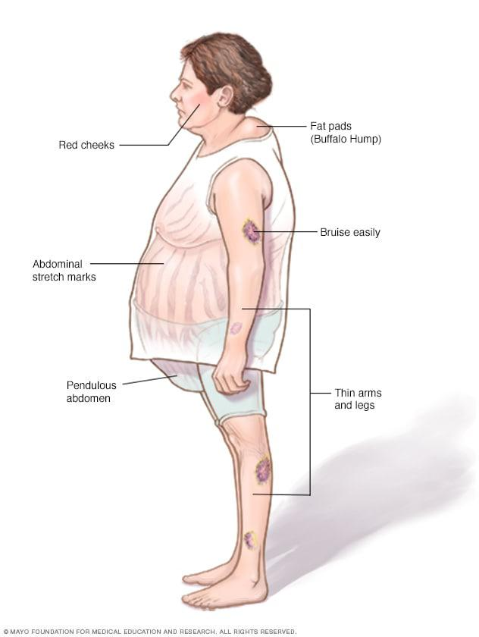
CUSHING SYNDROME

Slide 9
TYPES
Exogenous: Caused by long-term use of corticosteroid medicines.
ACTH-dependent: Excess ACTH causes the adrenal glands to produce too much cortisol.
* Pituitary tumor → Cushing disease
* Ectopic tumor → Excess ACTH from another part of the body
ACTH-independent: The adrenal glands produce too much cortisol on their own, usually due to an adrenal tumor.

Slide 10
SIGN AND SYMPTOM
Headache
Anxiety
Weight gain
Insert muscle weakness
Slower growth may occur despite weight gain in children
High blood sugar
Irregular menstrual periods in people who menstruate
Hypertension cause face flushing

Slide 11
INVESTIGATION
History taking and physical examination– checks symptoms and medication history.
24-hour urinary free cortisol – measures cortisol in urine.
Late-night salivary cortisol – checks if cortisol remains high at night.
Low-dose dexamethasone test – checks whether cortisol production can be suppressed.
Imaging (MRI/CT) – identifies possible pituitary or adrenal tumors.
Blood tests – check glucose, electrolytes, potassium, lipids, blood cells, kidney and liver function.
Bone mineral density – checks for osteoporosis.

Slide 12
MEDICAL MANAGEMENT
Gradually reduce corticosteroids ( prednisolone, dexamethasone, and hydrocortisone) if they are the cause; never stop suddenly.
Surgery to remove pituitary, adrenal, or ectopic ACTH-producing tumors.
Medications to reduce cortisol production ( ketoconazole, and metyrapone ) or block it’s effects ( mifepristone)
Radiation therapy may be used for some pituitary tumors when surgery is unsuccessful or unsuitable.
Treat complications such as hypertension, diabetes, osteoporosis, and infections.

Slide 13
NURSING MANAGEMENT
Monitor vital signs, blood pressure, blood glucose, and weight.
Monitor for infection and maintain good hygiene/aseptic technique.
Protect fragile skin and provide wound care.
Prevent falls and fractures due to muscle weakness and osteoporosis.
Encourage appropriate nutrition, including adequate protein, calcium, and vitamin D.
Assess and support the patient’s emotional and psychological well-being.
Educate the patient about medications, diet, follow-up, infection prevention, and not stopping steroids abruptly

Slide 14
NURSING DIAGNOSIS
Risk for Infection related to immunosuppressive effects of excess cortisol.
Risk for Injury related to osteoporosis, muscle weakness, and impaired mobility.
Imbalanced Nutrition: More Than Body Requirements related to altered metabolism and increased appetite, as evidenced by central obesity and weight gain.
Disturbed Body Image related to physical changes associated with Cushing syndrome, as evidenced by moon face and central obesity.
Activity Intolerance related to muscle weakness and reduced physical strength.
Impaired Skin Integrity related to thin, fragile skin and impaired tissue repair.

Slide 15
COMPLICATION
Hypertension.
Type 2 diabetes mellitus.
Osteoporosis and bone fractures.
Cardiovascular disease.
Growth impairment in children.
Psychological problems, such as depression, anxiety, and mood changes.
sexual dysfunction.

Slide 16
DIFFERENTIAL DIAGNOSIS
Pseudo-Cushing syndrome – caused by stress, depression, or chronic alcohol use.
Obesity/metabolic syndrome – causes central obesity, hypertension, and insulin resistance.
PCOS – may cause obesity, acne, excess hair, and menstrual problems.
Hypothyroidism – causes weight gain, fatigue, and weakness.
Long-term corticosteroid use – produces Cushing-like symptoms.
Adrenal or pituitary tumors – can cause excess cortisol production.

Slide 17
REFERENCES
National Institute of Diabetes and Digestive and Kidney Diseases. (2024). Cushing’s syndrome. U.S. Department of Health and Human Services.
National Institute of Diabetes and Digestive and Kidney Diseases. (2024). Cushing’s disease. U.S. Department of Health and Human Services.
Melmed, S., Auchus, R. J., Goldfine, A. B., Koenig, R. J., & Rosen, C. J. (Eds.). (2020). Williams textbook of endocrinology (14th ed.). Elsevier.
Jameson, J. L., Fauci, A. S., Kasper, D. L., Hauser, S. L., Longo, D. L., & Loscalzo, J. (Eds.). (2022). Harrison’s principles of internal medicine (21st ed.). McGraw Hill.
Gardner, D. G., & Shoback, D. (2018). Greenspan’s basic & clinical endocrinology (10th ed.). McGraw Hill.

